Slide 1
Software Architecture
Lecture 4-1.
Dataflow Systems and Batch sequential Architecture
数据流系统与批处理架构
Professor: Yushan (Michael) Sun
Fall 2023

Slide 2
Lecture 2. Dataflow Systems
Content of the lecture
Concept of dataflow architecture
Concept of Batch sequential architecture
Example of program designed in batch sequential architecture

Slide 3
Concept of Dataflow Architecture
数据流软件体系结构

Slide 4
Concept of Dataflow Architecture
数据流系统定义
定义：数据流系统是满足下列条件的系统，
数据的可用性控制着计算
设计的结构由数据在进程之间的有序运动决定的
数据的模式是明确的
Definition: A dataflow system is a system, in which
The availability of data controls the computation
The structure of design is dominated by orderly motion of data from process to process
The pattern of data is explicit

Slide 5
Concept of Dataflow Architecture
一般来说，数据可以以任意方式流动
当数据到达时，组件被激活，而无数据的时候，就休眠
我们对几乎线性的数据流系统感兴趣
或对较简单，高度受限的循环结构感兴趣
General architecture of dataflow architecture

Slide 6
Concept of Dataflow Architecture
关于控制流 (About Control flow)
我们关注程序中的控制流轨迹
We pay attention to the locus of control flow that moves through the program
数据可能伴随控制，但是数据不是主导 Data may accompany the control but is not dominant
我们关系程序的执行顺序 The order of execution of the program is concerned

Slide 7
Concept of Dataflow Architecture
设计方面的注意事项
数据是怎样流动的. Main concern is how data moves through a collection of (atomic) computations
随着设计流动，控制被激活 As data moves, control is activated
设计的考虑事项 Reasoning is about
数据的可用性 (data availability)
数据变换 (transformation) and
数据延迟 (Latency)

Slide 8
Concept of Dataflow Architecture
数据流系统的开发方法论
将系统分解为一些模块 Decompose system into modules
− Abstraction isolates complexity
− Operations performed on data objects
将模块组合成图 Compose modules into a graph
− Connect modules forming directed graph
− Interfaces are negotiated to match data types
运行该图 Run the graph
− Data flows between the modules
− scheduler automates parallelism
− memory manager optimizes memory usage
Return

Slide 9
Concept of Batch Sequential
Architecture
批处理软件体系结构的概念

Slide 10
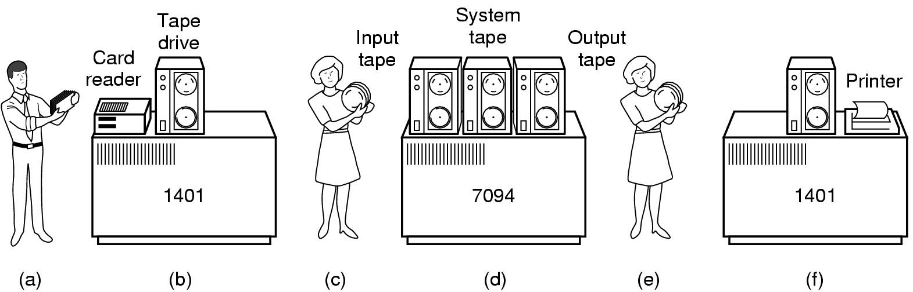
2. Concept of Batch Sequential Architecture
1960年代-1970年代数据处理的例子
Ibm1401 大型机。数据处理，1959年生产
大型机，IBM 1960制造， 28MB硬盘用于航天领域；1962生产
读取数据卡并
制作数据磁带
处理磁带以获取
感兴趣的数据
打印报告

Slide 11
2. Concept of Batch Sequential Architecture
批处理系统的定义. Definition of Batch sequential system：
Batch sequential process is formed by a sequence of processing steps, intermediating by some kind of storage, such as megatapes, hard disk, etc.
Each step will do some operation on the input storage to get some useful information or modify the contents of the source storage and then save the resultant data to its sink storage.
BC
Storage
1
BC
Storage
2
BC
Storage
3
BC
Storage
4
Proc 1
Proc 2
Proc 3
Batch sequential pattern

Slide 12
2. Concept of Batch Sequential Architecture
批处理系统的性质
Properties of a Batch sequential system:
处理步骤是独立的程序（任何两个处理步骤之间没有交互）
D1
D2
D3
D4
Proc 1
Proc 2
Proc 3
Proc1，Proc2和Proc3互不调用

Slide 13
2. Concept of Batch Sequential Architecture
批处理系统的性质
每一步在彻底运行完成之后，下一步才能开始
Proc1完整地处理完D1中的数据➔将数据存入D2
Proc2完整地处理完D2中的数据➔将数据存入D3
Proc3完整地处理完D3中的数据➔将数据存入D4
D1
Proc1
D2
Proc2
D3
Proc3
D4
c) 数据作为一个整体在各个步骤之间传输 （理解为一种特殊
的数据流；数据以块状的形态流动）

Slide 14
2. Concept of Batch Sequential Architecture
典型应用(Typical applications): classical data processing
早年的业务(商业)数据库处理方式
历史上，业务数据库处理主要由数据库更新控制：预定类型的离散交易；周期性定期报告；对错误请求的特殊处理。
Business database processing historically is dominated by database updates:
Discrete transaction of predetermined type;
periodic reports;
special handling of bad requests.

Slide 15
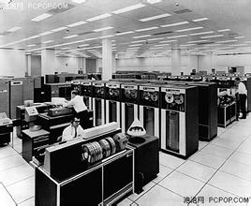
2. Concept of Batch Sequential Architecture
Historical database: batch sequential.
How to work?
大型机和磁带
每个步骤的手动区块调度计划
Mainframes and magnetic tape
Manual block scheduling plan for each step
关系型数据库出现在1980年代
IBM 7094
mainframe

Slide 16
2. Concept of Batch Sequential Architecture
【例 1】 批处理数据库更新程序
Online
Data
entry
T1
T2
T3
Edit
Sort
Application input
Reject
report
Computer
output
Print
Update1
Update2
Old
Master1
New
Master1
Old
Master2
New
Master2
Dataflow diagram for Batch Databases

Slide 17
2. Concept of Batch Sequential Architecture
1. 原始数据 (Raw data)
Sun, Mike | 356821 | TV | 888.56 | 324-56-7348
Liu, Elle | 672452 | 356 | 346-12-6788 | camera
Lee, Mary | 842674 | radio | 65.44 | 563-27-8977
Juell, Paul | 257215 | Telephone | 97.05 | 678-23-1567
Nygard, Ken | 573245 | Microwave oven | 56.88 | 974-67-8577
Magel, Ken | 834265 | refrigerator | 988 | 874-26-7847
Hunt, Paul | 332184 | Bicycle | 523 | 223-56-6878
Eric, Vosika | 257652 | jewellery | 1005 | 564-31-0976

Slide 18
2. Concept of Batch Sequential Architecture
2. 编辑完的数据 (Edited data)
Sun, Mike | 356821 | TV | 888.56 | 324-56-7348
Lee, Mary | 842674 | radio | 65.44 | 563-27-8977
Juell, Paul | 257215 | Telephone | 97.05 | 678-23-1567
Nygard, Ken | 573245 | Microwave oven | 56.88 | 974-67-8577
Magel, Ken | 834265 | refrigerator | 988 | 874-26-7847
Hunt, Paul | 332184 | Bicycle | 523 | 223-56-6878
Eric, Vosika | 257652 | jewellery | 1005 | 564-31-0976
Ejected data, wrong format
Liu, Elle | 672452 | 356 | 346-12-6788 | camera

Slide 19
2. Concept of Batch Sequential Architecture
3. 排序完的数据 (Sorted data)
Eric, Vosika | 257652 | jewellery | 1005 | 564310976
Hunt, Paul | 332184 | Bicycle | 523 | 223566878
Juell, Paul | 257215 | Telephone | 97.05 | 678231567
Lee, Mary | 842674 | radio | 65.44 | 563278977
Magel, Ken | 834265 | refrigerator | 988 | 874267847
Nygard, Ken | 573245 | Microwave oven | 56.88 | 974678577
Sun, Mike | 356821 | TV | 888.56 | 324567348

Slide 20
2. Concept of Batch Sequential Architecture
4. 将数据插入数据库 (Insert data into master database)
5. 更新数据库 (Update database)

Slide 21
2. Concept of Batch Sequential Architecture
在上面的示例中，顺序批处理图可以简单地重新绘制，如下所示。
Validate
Sort
Update
Report
Batch Sequential Database Architecture
Return

Slide 22
Example of program designed in
batch sequential architecture
批处理架构的例子

Slide 23
3. Example of design in Batch Sequential Architecture
【例2】千年虫与国名问题 (Year 2000 problem and country name)
在一个文本文档中，将纪年表示xx改为xxxx，例如，将89改为1989；将表达式荷兰“Holland” 改为尼德兰“Netherlands”
T1
legacy.txt
Input
T2
Y2K
T3
Country
Name
T4
Output
T5
new.txt
Legacy file update using batch sequential software architecture

Slide 24
3. Example of design in Batch Sequential Architecture
原始文件(Original txt file):
Television $3800 Japan 95-12-11
Television $3600 Germany 88-12-01
Microwave $3800 Japan 95-12-11
Microwave $3600 Germany 88-12-01
Television $3800 Holland 95-12-11
Television $3300 Germany 89-02-01
Microwave $3800 Holland 95-12-11
Microwave $3300 Germany 89-02-01
Washing Machine $3800 Japan 95-12-11
Washing Machine $3600 Germany 88-12-01
Television $3800 Holland 95-12-11
Television $3300 Germany 89-02-01
Washing Machine $3800 Holland 95-12-11
Washing Machine $3300 Germany 89-02-01

Slide 25
3. Example of design in Batch Sequential Architecture
经过Y2K过滤器之后 (in Tape 3):
Television $3800 Japan 1995-12-11
Television $3600 Germany 1988-12-01
Microwave $3800 Japan 1995-12-11
Microwave $3600 Germany 1988-12-01
Television $3800 Holland 1995-12-11
Television $3300 Germany 1989-02-01
Microwave $3800 Holland 1995-12-11
Microwave $3300 Germany 1989-02-01
Washing Machine $3800 Japan 1995-12-11
Washing Machine $3600 Germany 1988-12-01
Television $3800 Holland 1995-12-11
Television $3300 Germany 1989-02-01
Washing Machine $3800 Holland 1995-12-11
Washing Machine $3300 Germany 1989-02-01

Slide 26
3. Example of design in Batch Sequential Architecture
经过country name过滤器之后 (in Tape 4):
Television $3800 Japan 1995-12-11
Television $3600 Germany 1988-12-01
Microwave $3800 Japan 1995-12-11
Microwave $3600 Germany 1988-12-01
Television $3800 Netherlands 1995-12-11
Television $3300 Germany 1989-02-01
Microwave $3800 Netherlands 1995-12-11
Microwave $3300 Germany 1989-02-01
Washing Machine $3800 Japan 1995-12-11
Washing Machine $3600 Germany 1988-12-01
Television $3800 Netherlands 1995-12-11
Television $3300 Germany 1989-02-01
Washing Machine $3800 Netherlands 1995-12-11
Washing Machine $3300 Germany 1989-02-01

Slide 27

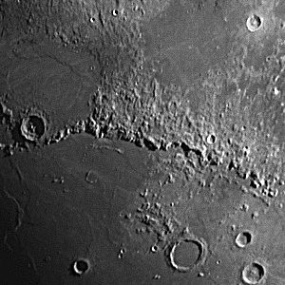
【例3】批处理架构在图像处理中的应用
3. Example of design in Batch Sequential Architecture
Batch sequential architecture can be used to do image processing
Picture before and after image sharpening

Slide 28
图像处理(image processing)
基本知识：一幅图片使用一个
216 X 216；或者
512 X 512; 或者其它
的矩阵表示。矩阵中的元素是0~255的正整数，叫做灰度值，0代表纯粹的黑色，255代表白色；其余介于0与255之间的数值，代表灰色。
每一个元素具有一个特定的位置（x, y）和灰度值f(x, y),这些元素就称为像素。
图像处理是按照一定的算法，对图像像素的灰度值进行变换。

Slide 29
3. Example of design in Batch Sequential Architecture
设计考虑设计一个图像处理软件。该软件包含一些可以随时添加的过滤器（filters），例如
Blurring (图像模糊)，
Sharpening (图像锐化)
Brightening (图像变亮)
EdgeDetector (发现图像边界)，
一些过滤器被串联在一起，以便完成一些比较复杂的功能。

Slide 30
3. Example of design in Batch Sequential Architecture
img.jpg
T1
T2
T3
T4
Blur
Brighten
EdgeDetect
Sharpen
T5
newImg.jpg
顺序批处理体系结构的数字图像处理系统对象逻辑图

Slide 31
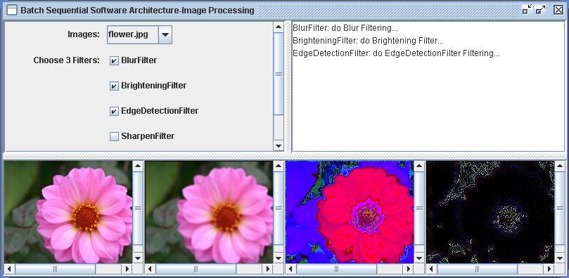
3. Example of design in Batch Sequential Architecture
顺序批处理软件用户界面图

Slide 32
3. Example of design in Batch Sequential Architecture
【例4】: 利用批处理架构设计的一个人口信息处理程序。
项目需求：设计与实现一个人口信息处理程序。
将一个大的人口数据文件按照性别、年龄分为多个文件
使用批处理体系结构进行设计，如下图所示。

Slide 33
Beijing.txt
Woman.txt
Man.txt
ForkInputProc
WomanProc1
Woman18-.txt
ManProc1
Man18-.txt
Woman18+.txt
Man18+.txt
WomanProc2
Woman25+.txt
ManProc2
Man25+.txt
Woman18-25.txt
征兵对象
Man18-25.txt
征兵对象
人口信息处理程序软件体系结构图

Slide 34
设计类图如下：
ClientGUI
AssemblyOfPipeLines
<<interface>>
BatchProcessor
+process()
ForkInputProc
WomanProc1
WomanProc2
ManProc1
ManProc2
+process()
+process()
+process()
+process()
+process()
评论：批处理架构盛行的年代是70-80年代；其时使用C语言等写各个处理过程，因此各个处理过程是独立的程序。现在使用Java语言进行设计的年代，可以写层次类。

Slide 35
3. Example of design in Batch Sequential Architecture
Project 2: 你的任务：
在以上设计中，ClientGUI类，AssemblyOfPipeLines 类，BatchProcessing类, ForkInputProcessor类和WomanProcessor1类已经实现（写完代码）。
你的任务是写代码实现WomanProcessor2类，ManProcessor1类和ManProcessor2类
Return

